Slide 1
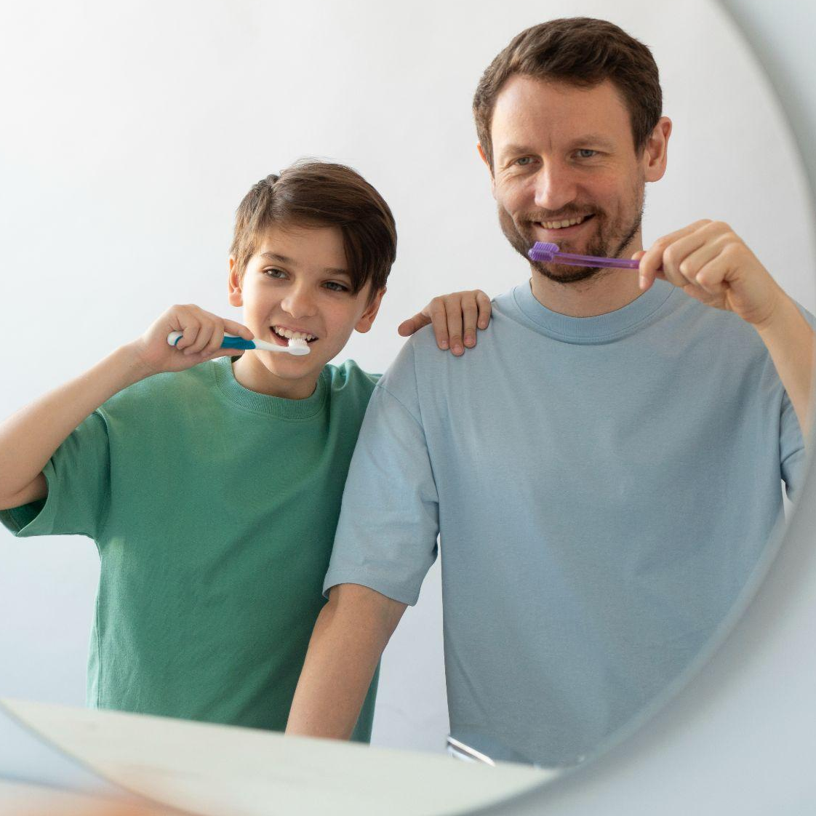

WELCOME TO THE PATTERNS COMPANY

Slide 2
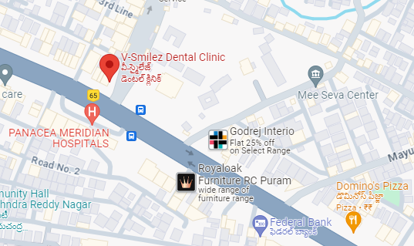

Geographic Location Beeramguda
https://www.vsmilezdental.com//
1st Floor, beside Beeramguda Main Road, Mallikarjuna Nagar, Beeramguda, Ramachandrapuram, Hyderabad, Telangana 502032.

Slide 3
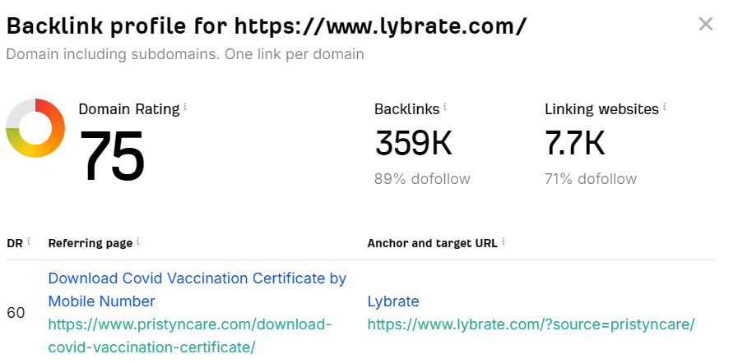
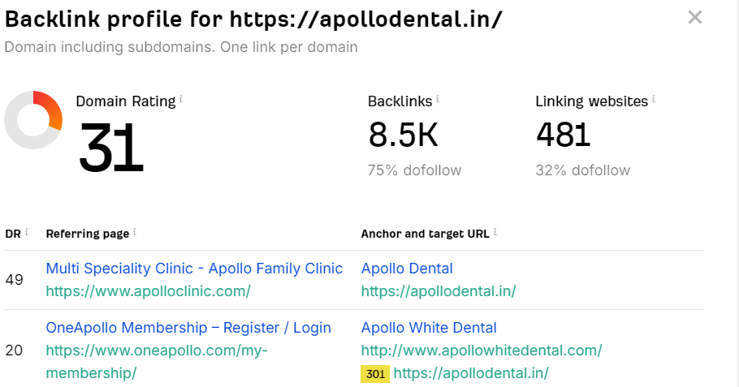
Competitors Of V-Smilez Dental Clinic
02
01
Lybrate
Apollo

Slide 4
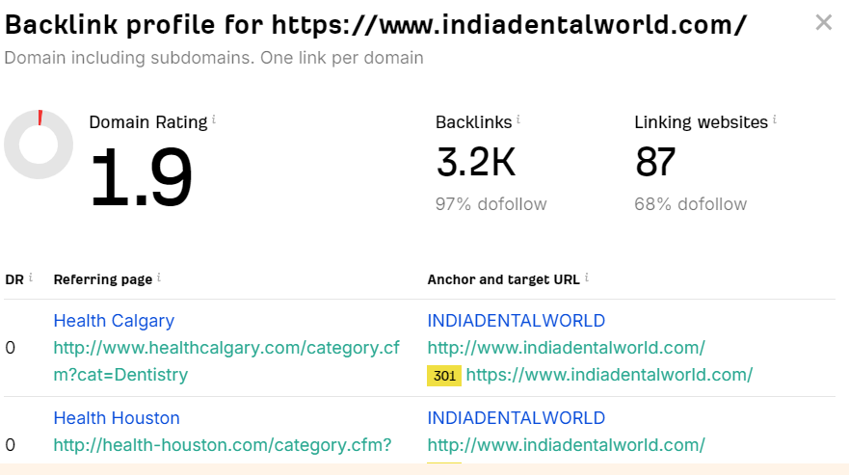
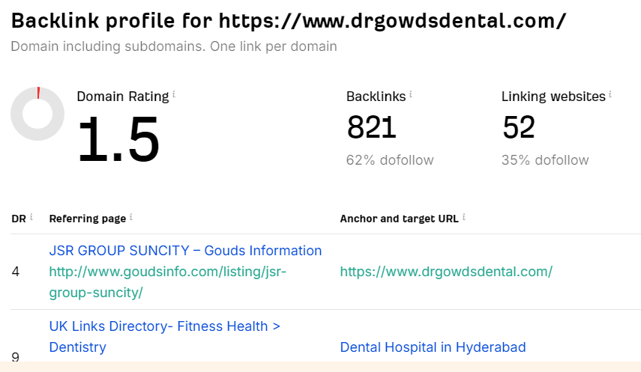
Competitors Of V-Smilez Dental Clinic
04
03
India Dental
Dr Gowds Dental

Slide 5
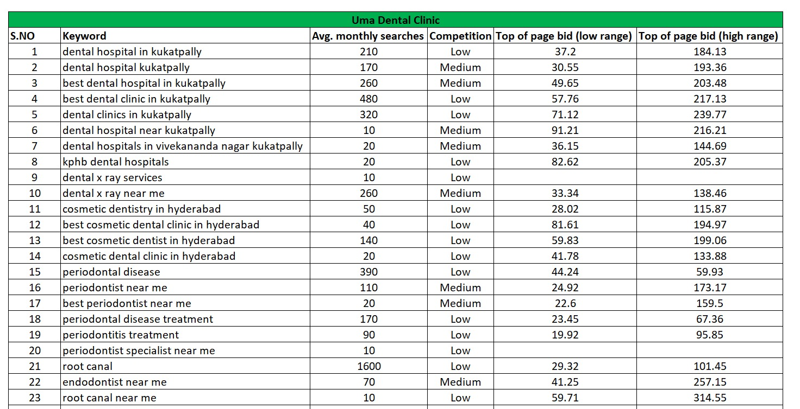
Keywords

Slide 6
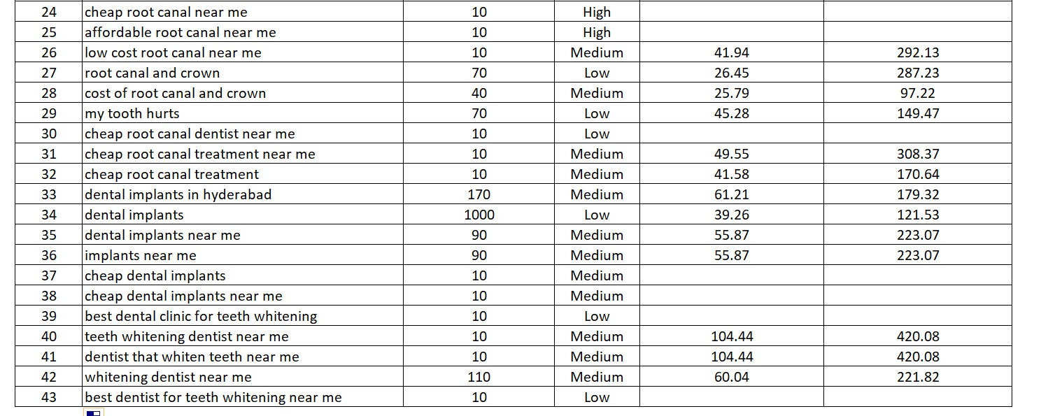
Keywords

Slide 7


Our Mission To The V-Smilez Dental Clinic
Daily SEO Submissions
120 Backlinks Per Day
24 Working Days
120*24=2,880 Backlinks Per Month

Slide 8





Social Media Marketing
Monthly Social Media Postings In Facebook,LinkedIn, Instagram, YouTube & Twitter
20 Postings Per Month
4 Reels Per Month

Slide 9


Meta Ads And Google Ads
We Will Also Run Meta And Google Ads.
We Will Also Give 30 Reviews To Your Google My Business Profile.

Slide 10
Thank You!
Do you have any questions?
info@thepatternscompany.com
+91 8500693113
thepatternscompany.com

